Slide 1
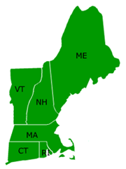
MA VOAD
The purpose and objectives of Massachusetts Voluntary Organizations Active in Disaster shall be to foster more effective service to people affected by disaster through communication, coordination, cooperation, collaboration, convening mechanisms and outreach.
National VOAD & 6-State VOAD

Slide 2
A coalition of nonprofit organizations that respond to disasters as part of their overall mission

Slide 3
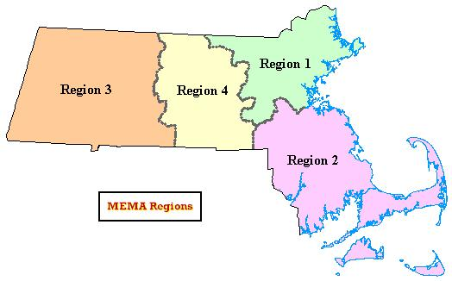
The 4 C’s
Communication State/Territory VOADs communicate needs to responding non-profits and agencies.
Cooperation Work within the VOAD Movement to share resources and ensure community needs are met.
Coordination Once on the ground State/Territory VOADs coordinate response efforts to ensure the delivery of those goods and services to communities affected by disaster.
Collaboration Continue to work together across all levels, from Local VOADs/COADs to Federal agencies, to ensure that communities are made whole following disasters.

Slide 4
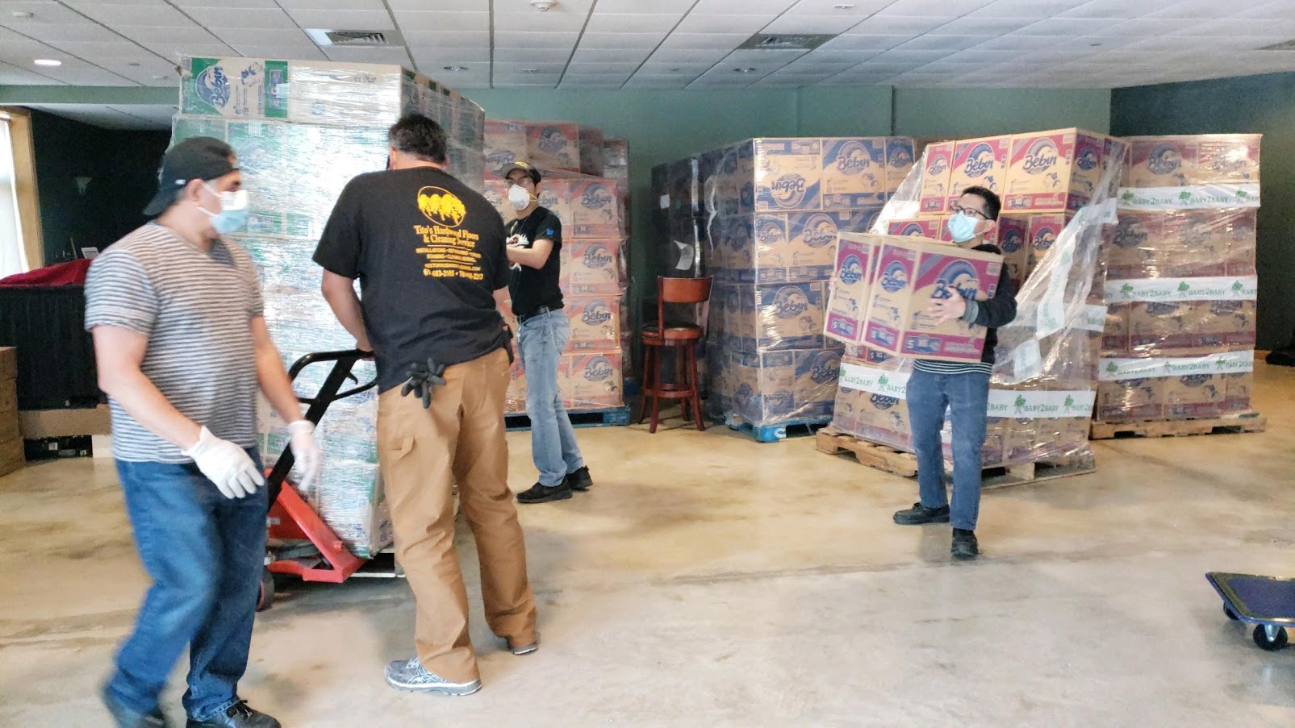
MAVOAD Role
Coordination, not response
Member organizations maintain their own identity & Independence
Collaborate with other MA VOAD members and local, state or federal authorities
Perform and deliver actual disaster response services
Services are at no cost to disaster victims or to governmental agencies

Slide 5
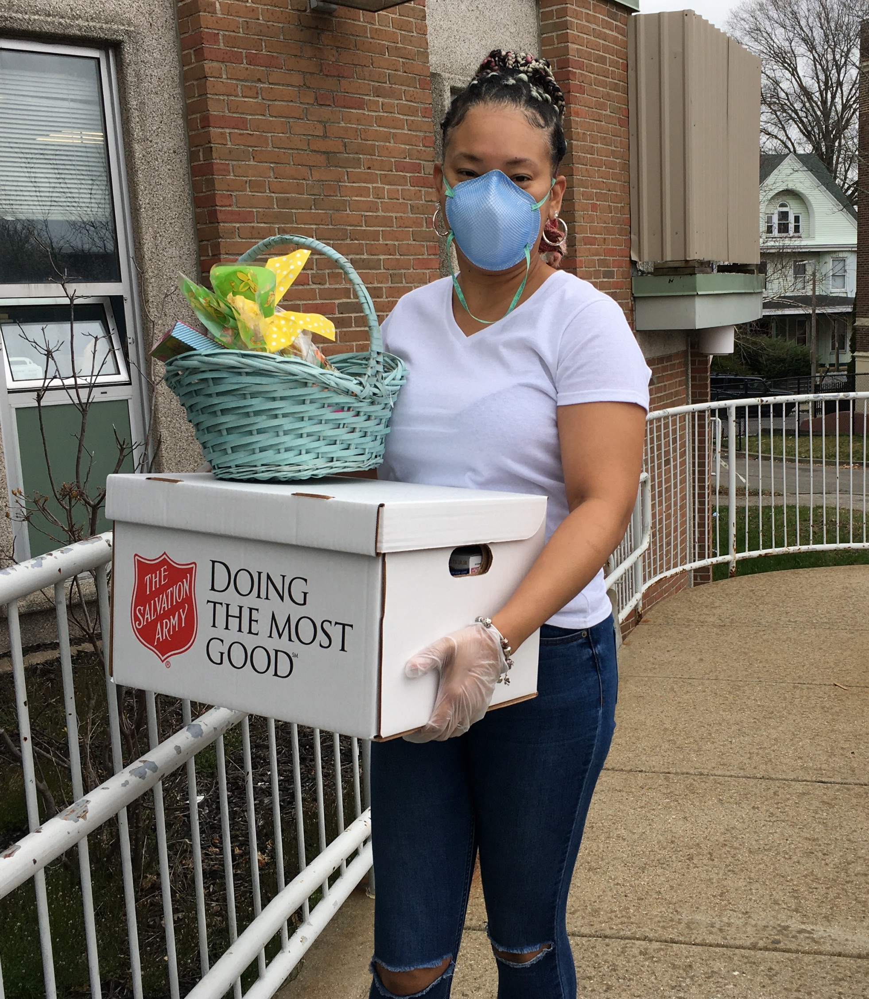
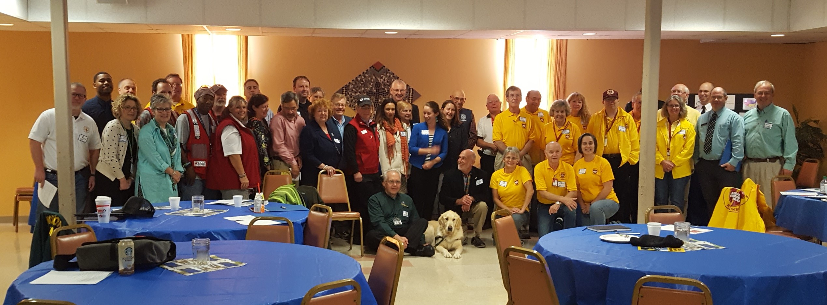
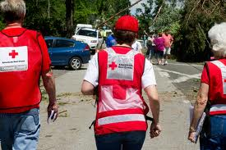
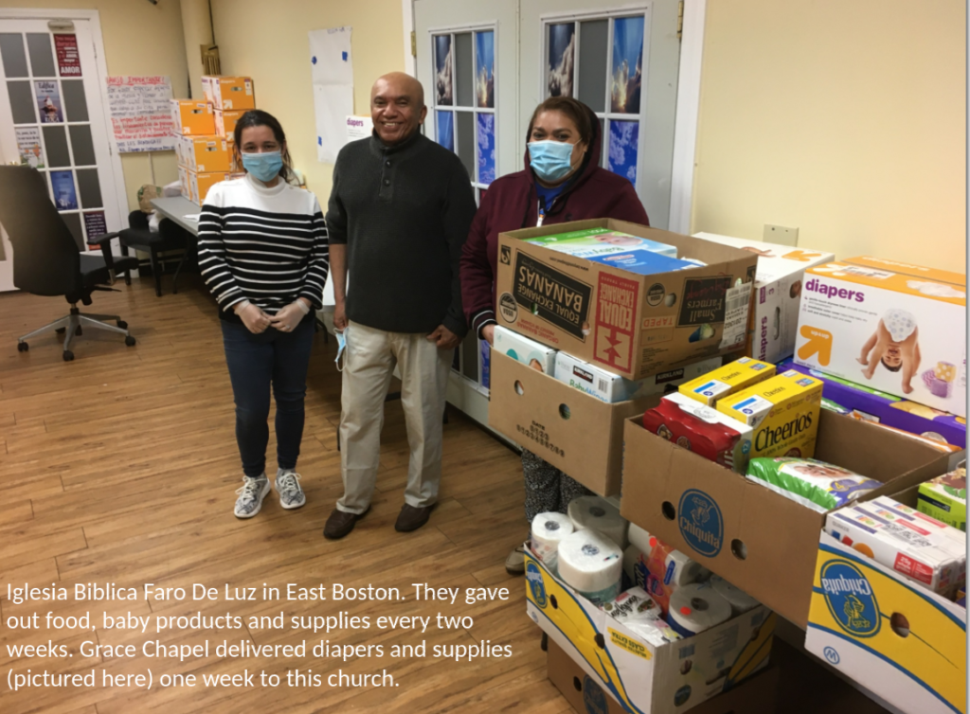
Key Areas of Service Supported by MAVOAD:
Disaster Case Management
Donations Management
Emotional and Spiritual Care
Government Relations
Long Term Recovery Groups
Mass Care (Feeding/Sheltering)
Communications
Volunteer Management
Training
Animal Care
Muck-outs, Tree and Debris removal

Slide 6
MEMA
MAVOAD works very closely with Massachusetts Emergency Management Agency (MEMA) whose primary responsibility is to ensure the state's resilience to disasters.
We also work with FEMA, DPH and Dept of Elder Affairs

Slide 7
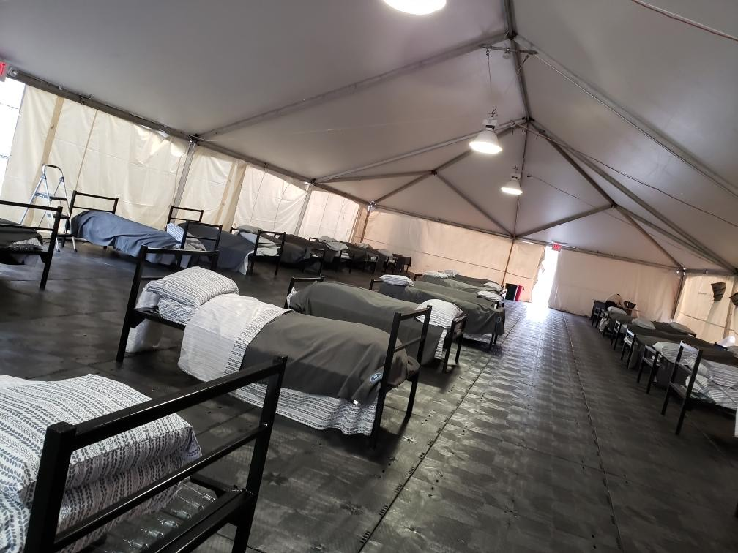
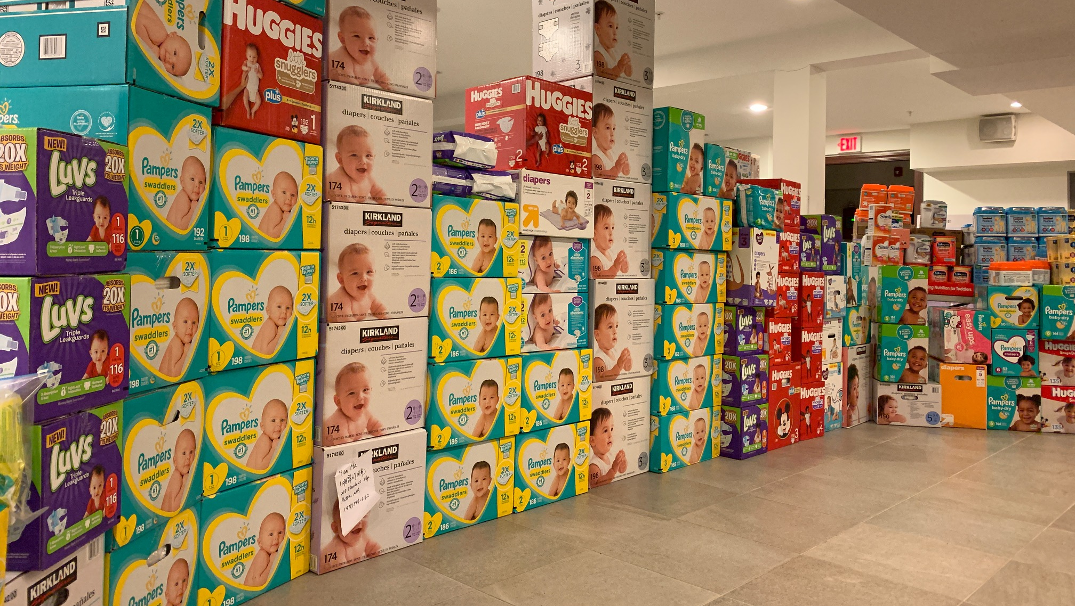
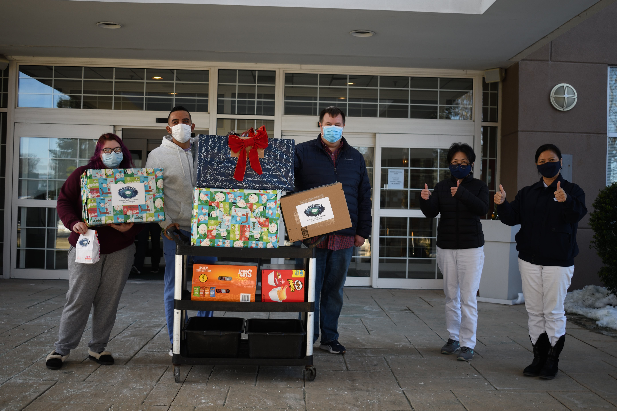
Recent COVID -19 Responses
Diaper Drive – Greater Boston area
Blankets/pillows for Homeless COVID Shelters
COVID 19 Isolation Centers
Clothing
Thanksgiving & Christmas
Food boxes for individuals
PPE distribution
Local Fires
Revere & Holliston

Slide 8
MAVOAD Values
Care and compassion for all people
A coordinated & inclusive approach so that disaster response agencies will flourish
Use best practices and practice mutual accountability
We work in a respectful, non-judgmental, and non-discriminatory manner
Trust, mutual respect, and equal partnerships of all community service providers
Providing hope – making a difference – offering opportunities for true collaboration – are the lifeblood and soul of the organization

Slide 9
American Red Cross of Massachusetts
Team Rubicon
Salvation Army EDS of MA
Seventh Day Adventist Relief
Eastern & Western MA ARES (amateur Radio)
SMART – State of MA Animal Response Team
UMCOR – United Methodist Committee on relief
Presbyterian Disaster Relief
International Orthodox Christian Charities Disaster Response
Americares
Samaritan's Purse
Greater Boston Food Bank
Southern Baptist Relief
Child Life Disaster Response
Tzu Chi Foundation
Operation BBQ
Scientology Disaster Relief
HOPE Animal Assisted Crisis Response
Boston Cares
Mass Service Alliance
Reuse Durable Medical Equipment
Episcopal Disaster Relief
ICNA Relief
Stavros
Central MA DART
Medical Reserve Corps (across MA)
CREW (Communities responding to Extreme Weather) Better Future Project
Emanuel Gospel Center
Worcester County Food Bank
NEDCA – New England Disaster Chaplaincy Association
Mass Corps of Fire Chaplains
New England Support Team
Vibrant
NECHAMA
Civil Air Patrol
Self Help Inc
United Ways
Mennonites Disaster Services
World Renew
Catholic Charities
SANDS – Sictuate Alliance of Natural Disasters

Slide 10
Co-Chairs
Secretary & Member Coordinator
Leadership Support
George Heake
Team Rubicon
George.Heake@teamrubiconusa.org
(413) 320-7264
Emily Mew
Salvation Army
emily.mew@use.salvationarmy.org
(413) 519-1673
Lucy Costa
American Red Cross
Lucy.Costa@redcross.org
(617) 435-6776
Eric Olsen
Team Rubicon
eric.olsen@teamrubiconusa.org
(508) 494-5001
MAVOAD
Leadership
mavoad@gmail.com

