Slide 1
The Medical Reserve Corps (MRC)
Name of Presenter
Organization
Date

Slide 2
What is the MRC?
The Medical Reserve Corps (MRC) is a national network of volunteers, organized locally to improve the health and safety of their communities
The MRC started as a demonstration project by the U.S. Department of Health and Human Services (HHS) in 2002 after the events of September 11 identified a need to organize and train medical volunteers to assist in emergencies
In 2006, Congress passed the Pandemic and All-Hazards Preparedness Act, which formally established the Medical Reserve Corps “to provide for an adequate supply of volunteers in the case of a Federal, State, local, or tribal public health emergency”
Today, the MRC network comprises approximately 850 units and 175,000 volunteers across the U.S. and its territories

Slide 3
What does the MRC do?
MRC units engage in their local communities to improve emergency response capabilities, build community preparedness and resilience, and strengthen public health
No MRC unit is the same – specific engagement activities vary by community need, volunteer skills and interest, and partner support

Slide 4
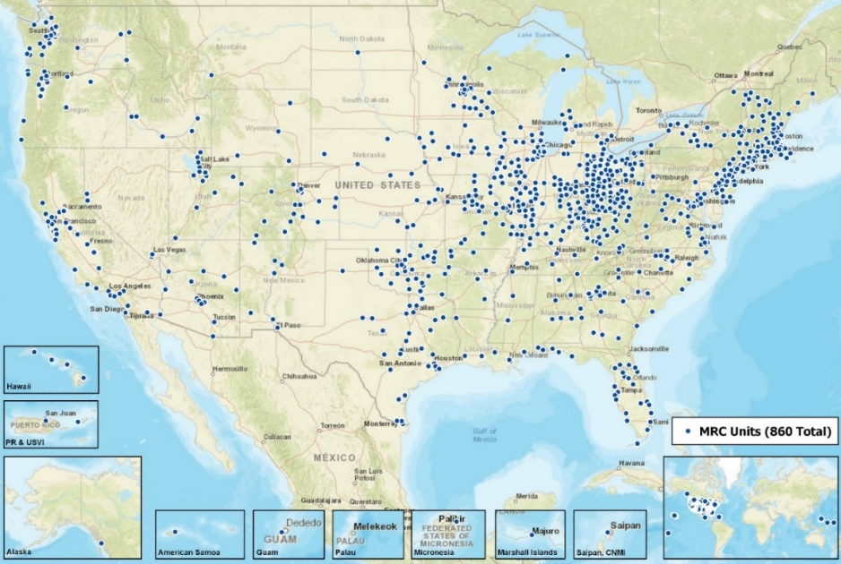
Where are MRC units located?
There are roughly 850 MRC units located across the U.S. and its territories, including:
49 states
American Samoa, Guam, Federated States of Micronesia, Marshall Islands, Palau, Puerto Rico, and Northern Mariana Islands
Size of MRC units ranges from fewer than 50 to more than 2,500 volunteers

Slide 5
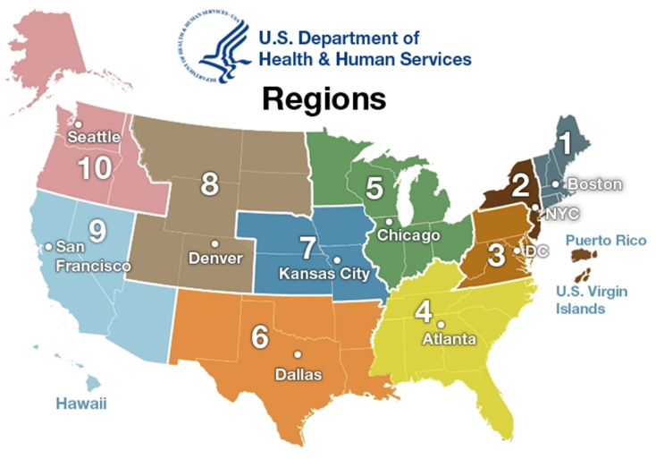
Number of MRC Units by Region
Data as of April 2020

Slide 6
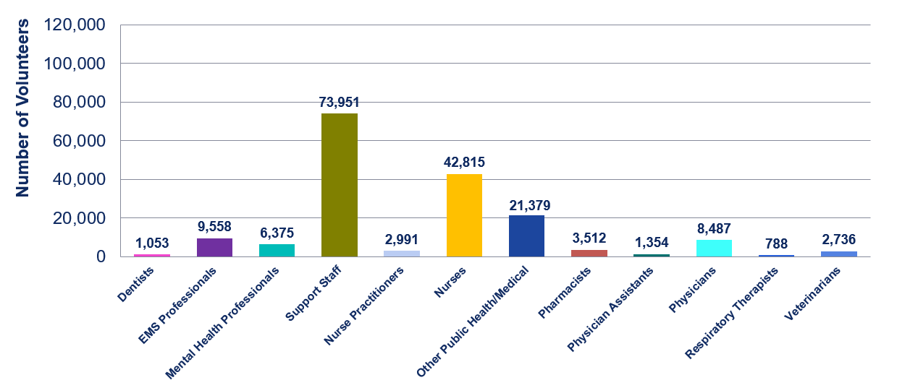
Types of MRC Volunteers
Data as of April 2020

Slide 7
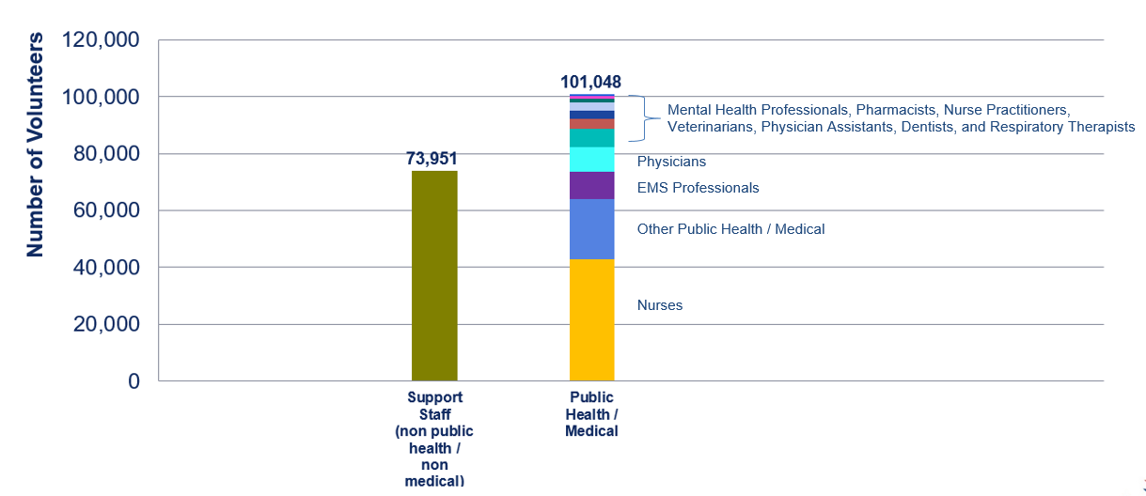
Types of MRC Volunteers
Data as of April 2020

Slide 8
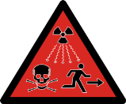
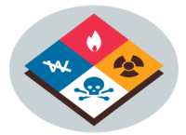
At a Glance: MRCs in the Community
In the most recent MRC Network Profile, below are the types of emergency responses MRC units participated in.
Natural Disasters
68%
Infectious Disease Outbreaks
28%
Human Induced / Civil Hazards
12%
Technological
Hazards
4%
Foodborne Illness
3%
Hazardous Materials Spills
3%
Other Emergencies
17%
Source: 2017 MRC Network Profile

Slide 9
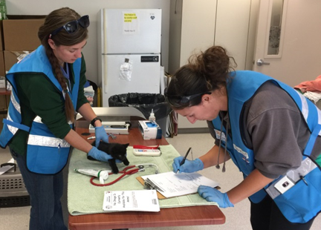
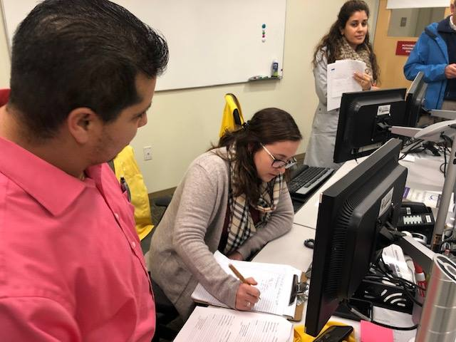
Examples of Fiscal Year 2019 Responses
More than 400 responses to local emergencies in Fiscal Year 2019 – examples include:
More than 10 MRC units supported wildfire response efforts in Northern and Southern California. Units assisted with resident evacuation, sheltering, veterinary care, and mask distribution
MRC units in Alabama and Mississippi devoted more than 2,000 hours to emergency responses related to tornadoes
MRC volunteers in Virginia provided more than 700 hours of mental health support as members of crisis teams to employees affected by the mass shooting at a municipal building in Virginia Beach. The MRC units also established two volunteer management centers
Several MRC units responded to floods, including assisting with emergency operations center support, shelter operations, veterinary care, tetanus immunizations for first responders, and debris clean-up
MRC units responded to communicable disease outbreaks in local communities, including hepatitis A and measles

Slide 10
MRC Program Communications
Visit the MRC website at https://mrc.hhs.gov
Join the MRC Program Office’s One-way or Two-way Listservs: https://mrc.hhs.gov/pageViewFldr/MRCListservs
Join MRC-TRAIN: https://www.train.org/mrc/
Like us on Facebook: https://www.facebook.com/medicalreservecorps
Follow us on Twitter: @MRC_ASPR or visit https://www.twitter.com/MRC_ASPR
To find an MRC unit near you, visit http://mrc.hhs.gov/FindMRC

